Slide 1
Entering
God’s
Presence
www.AbidingRoom.com

Slide 2
ENTERING
^{The Holy Temple}
www.AbidingRoom.com

Slide 3
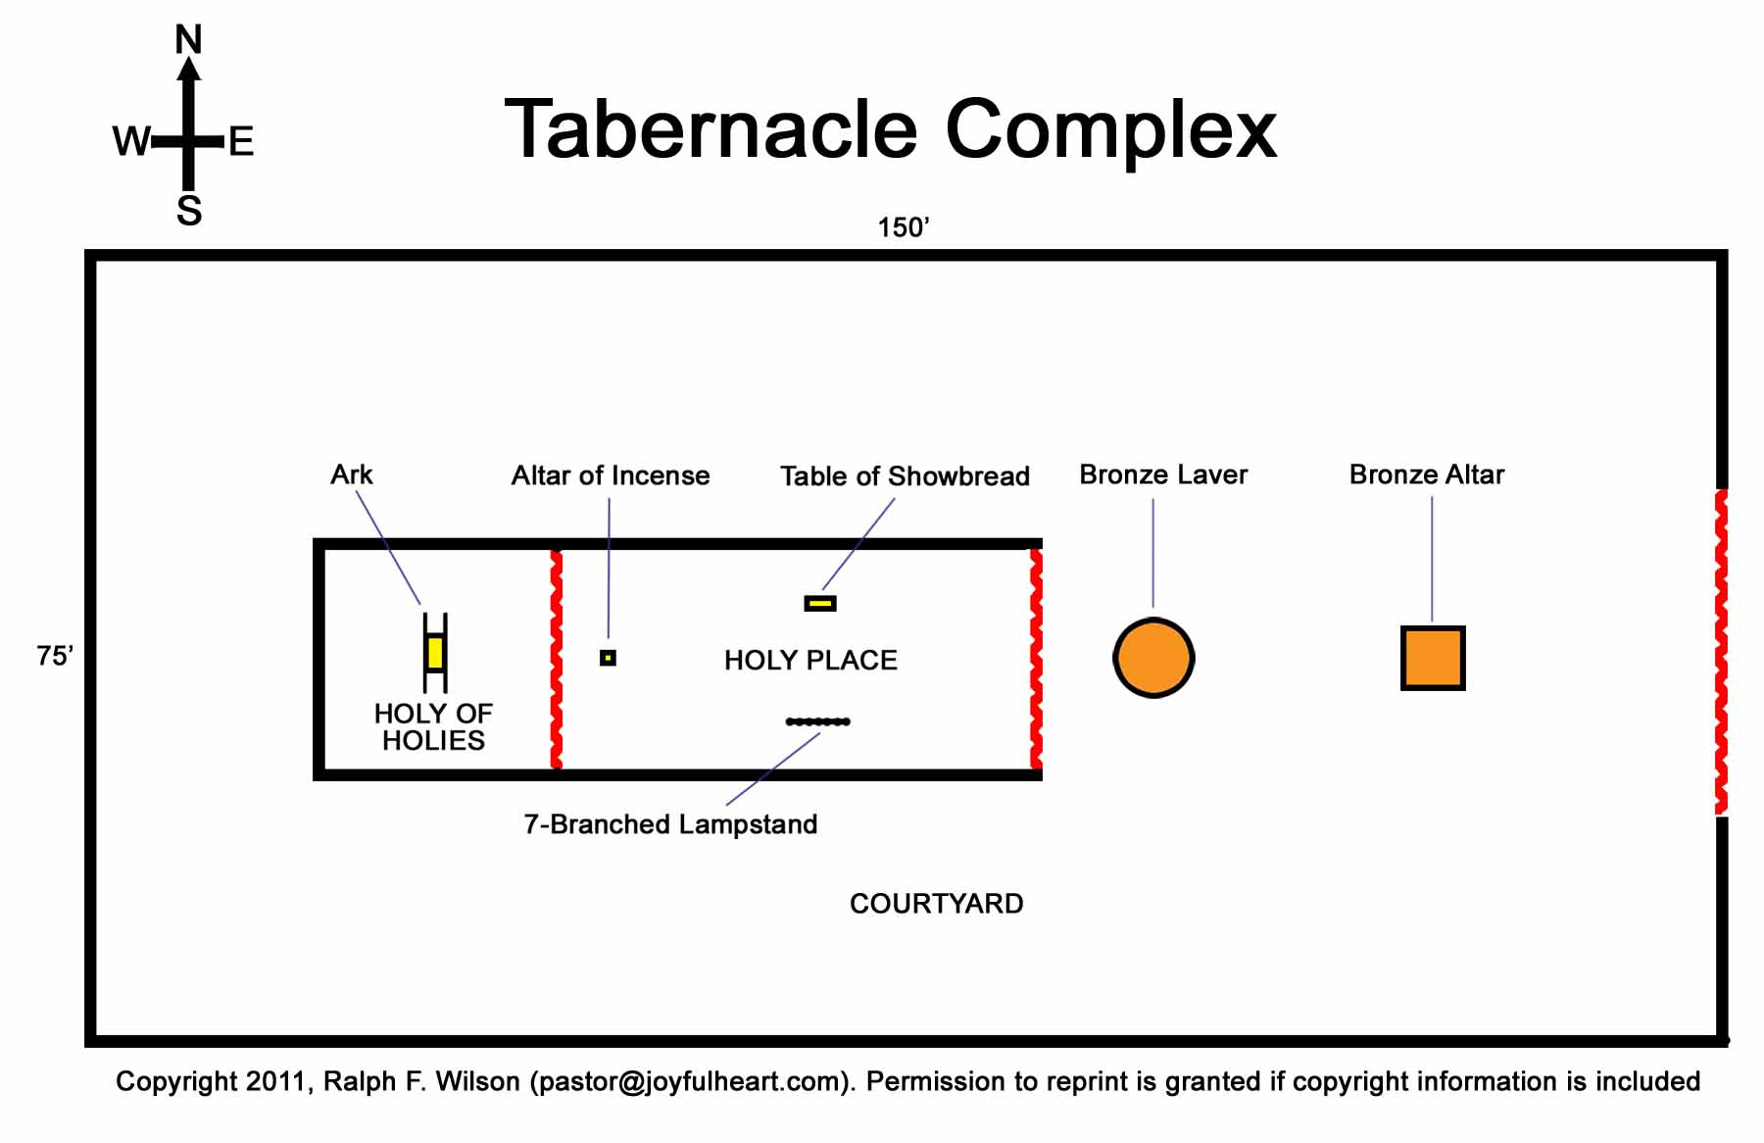

Slide 4
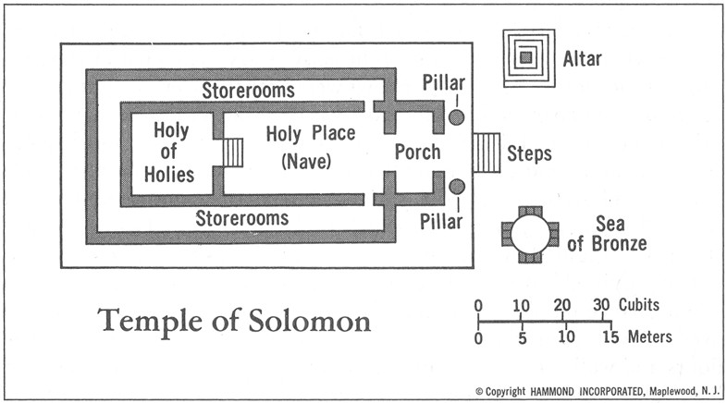

Slide 5
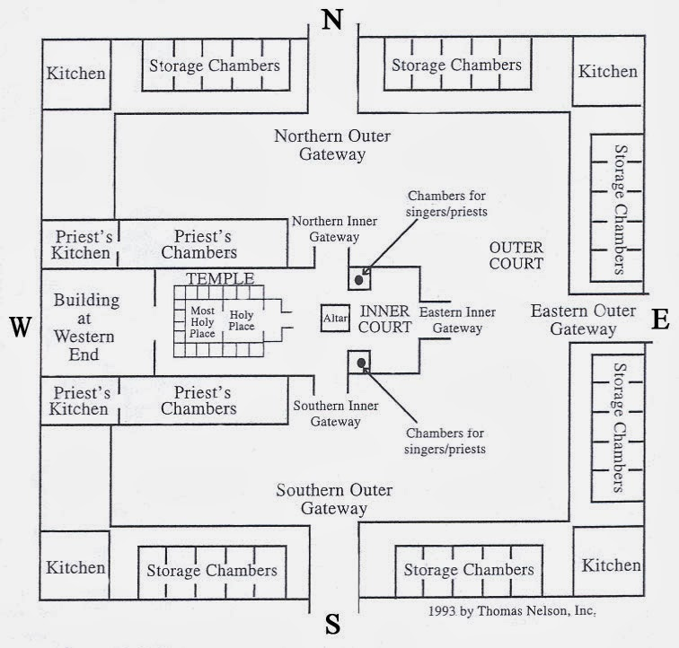

Slide 6
Hebrews 9:11,12
More Perfect Tabernacle
“When Christ came as high priest of the good things that are already here, he went through the greater and more perfect tabernacle that is not man-made, that is to say, not a part of this creation.”
www.AbidingRoom.com

Slide 7
Hebrews 8:1,2
True Tabernacle
“The point of what we are saying is this: We do have such a high priest, who sat down at the right hand of the throne of the Majesty in heaven, and who serves in the sanctuary, the true tabernacle set up by the Lord, not by man.”
www.AbidingRoom.com

Slide 8
Hebrews 6:19,20
Inner Sanctuary
“We have this hope as an anchor for the soul, firm and secure. It enters the inner sanctuary behind the curtain, where Jesus, who went before us, has entered on our behalf. He has become a high priest forever, in the order of Melchizedek.”
www.AbidingRoom.com

Slide 9
Hebrews 10:19-22
Most Holy Place
“Therefore, brothers, since WE have confidence to ENTER the Most Holy Place by the blood of Jesus, by a new and living way opened for us through the curtain, that is, his body, and since we have a great priest over the house of God, let us draw near to God with a sincere heart in full assurance of faith, having our hearts sprinkled to cleanse us from a guilty conscience and having our bodies washed with pure water.”
www.AbidingRoom.com

Slide 10
I. Outer Court
You are a Temple of God
(1 Cor 3:16)
II. Inner Court
Curtain/Veil
- Most Holy Place
- Holy of Holies
- True Tabernacle
- Inner Sanctuary

Slide 11
1 Corinthians 3:16
“Don't you know that you yourselves are God's temple and that God's Spirit lives in you?”
www.AbidingRoom.com

